Slide 1

Hardware Security
OCdt Alan Middleton C/ Nolen Shubin
Mr Quillen Flanigan
Conjure-2
UK - 07/08/2023 US - 08/07/2023
Notes:
Q

Slide 2
Scope
Introduction
Background
Methods
Results
Discussion
Notes:
Q

Slide 3
Introduction
Notes:
Q

Slide 4
Introduction
Hardware is not invulnerable
Complex supply chain of chips
Backdoor in microprocessor to disable Syrian radar
Weapon systems have numerous chips that could be exploited.
Hardware vulnerabilities Bypass Software defences
Notes:
Q

Slide 5
Introduction - Assumptions/Limitations
Assuming hardware we are testing on has not been compromised yet
Could have been compromised during manufacturing
Would limit the applicability and accuracy of our solution
Assuming a secure serial communication protocol
Have to assume the challenge-response pairs are valid and correct with no errors during communication
Assume there is no external influence affecting the performance or output of our design
Notes:
Q

Slide 6
Introduction - The Problem
We have an FPGA-based PUF
We want to protect it from hardware trojans
Create a ring oscillator
Calculate the frequency of oscillation
Implement a C program to facilitate serial communication

Slide 7
Background

Slide 8
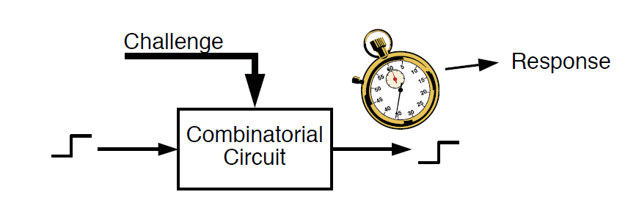
Background - FPGA & PUFs
Field Programmable Gate Array
Quick design and test of hardware logic
Programmed to run specialized tasks more efficiently
Physical Unclonable Function
Used to fingerprint a circuit
Figure 1. Proof of concept for PUF

Slide 9
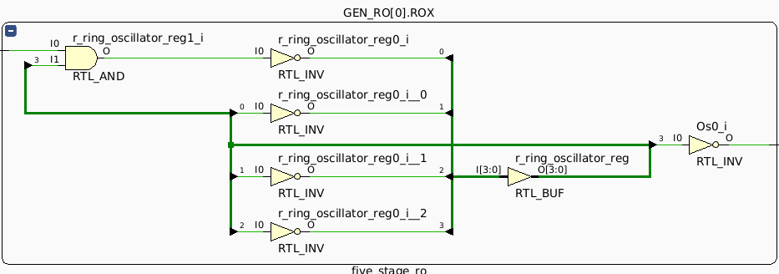
Background - VHDL
VHSIC Hardware Description Language
Very High Speed Integrated Circuit
DoD Program VHSIC developed it to create custom chips for high performance
Used to program hardware devices with low level logic
Can generate schematics to represent code
Helps visualize implemented logic
Figure 2. VHDL schematic
Notes:
Nolen

Slide 10
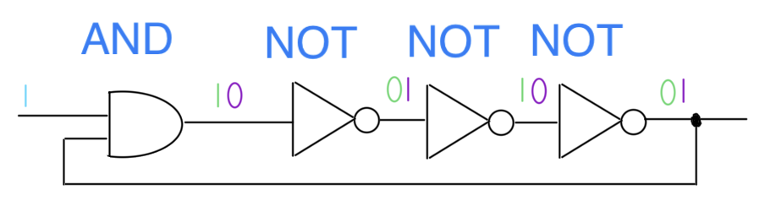
Background - Ring Oscillators
Circuit creates oscillations in output
Frequency of oscillation is unique between circuits
Uses AND and odd number of NOT gates to create oscillations
Figure 3. Logic of Ring Oscillator
Notes:
Nolen

Slide 11
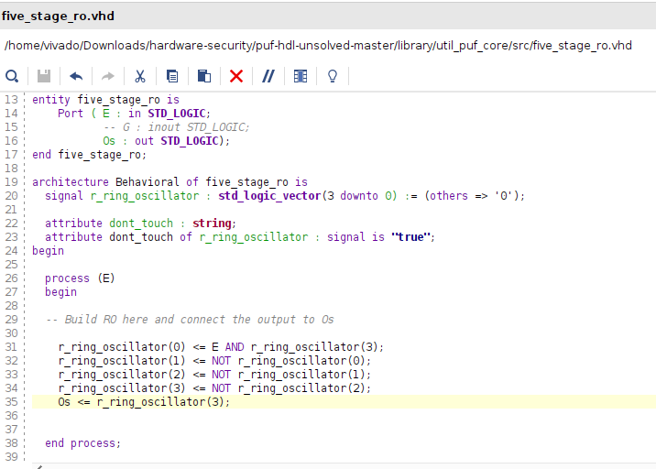
Methods - Ring Oscillator
Provided with three declared pins/signals
Ports are Enable, Os
Given a signal vector named ‘r_ring_oscillator’
Vector represents the oscillating signal
AND gate combines the Enable pin and oscillating signal vector
Provides more stability
Used three NOT gates to oscillate signal
Figure 4. Complete VHDL code of ring oscillator design
Notes:
Q

Slide 12
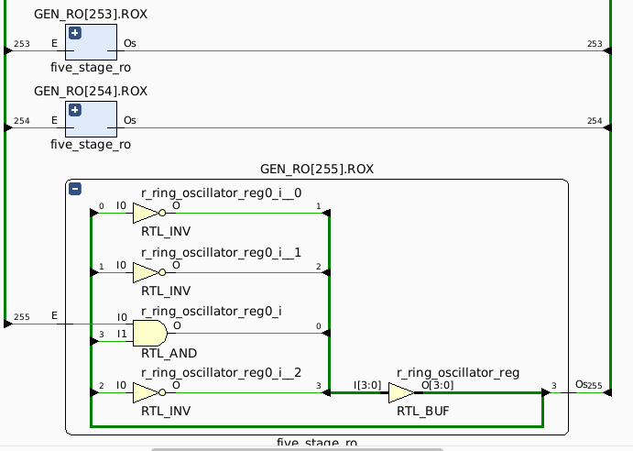
Methods - Ring Oscillator Integration
Run simulation of RO and generate schematic
Schematic can verify correct VHDL code
Oscillator then integrated into the FPGA-based PUF
Contains 256 instances of our ring oscillator
Make the VHDL project, generate bitstream, program device
Figure 5. Vivado schematic of ring oscillator
Notes:
Q

Slide 13
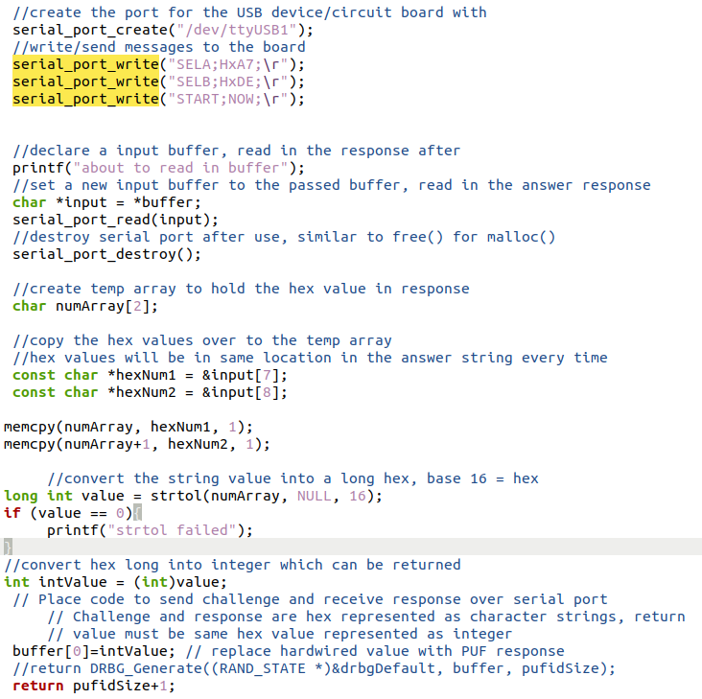
Methods - Serial Port Communication
Used to send & receive CRPs
Use provided functions to connect to our device
Serial_port_create(), write(), read()
Send messages to device - PUF processes the input and maps to a unique output
Process the received response
Convert hexadecimal characters to integers
Return converted integer value
Figure 8. Full C program for serial communication
Notes:
Q

Slide 14
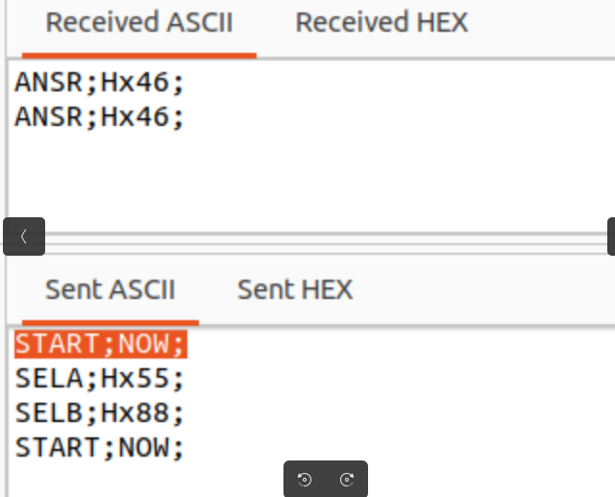
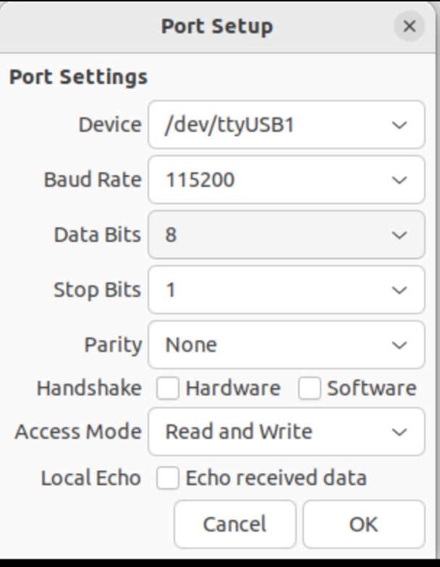
Methods - Moserial Testing
Sudo apt install moserial
Use moserial to send and receive CRPs to our device
Serves as a test to verify accuracy & reliability of code
Figure 7. Verification of reliable PUF & RO
Figure 6. Moserial settings
Notes:
Nolen

Slide 15
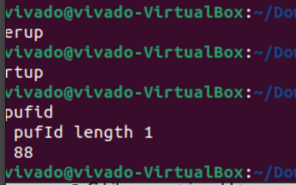
Methods - Executing C Program - Testing CRP
Setup the TPM server and client once C code was complete
‘make’ in server directory to compile all source/header files, create server binary
./tpm_server
‘make -f makefiletpmc’ within the client directory
Creates necessary binaries to execute our C function
./powerup, ./startup, ./getpufid
Output displayed in client terminal
Should be the same value as the hex value from PUF response
Figure 9. Client producing output from PUF CRP
Notes:
Alan

Slide 16
Results - Overview of Solution
Successfully completed design of RO and serial communication
Successful in testing the integrated FPGA-based PUF and communication to our device with the TPM client-server system
Verified accuracy and reliability with moserial
Not able to find frequency or gate delay of RO
Notes:
Alan

Slide 17
Results - PUF Quality Metrics
Reliability:
Our design proved to be reliable in producing consistent CRPs
Can serve as authentication, private-key generation
Uniqueness:
Our design was able to generate a unique CRP for most of our input
Had one case (0x55, 0x88) where another group had the same response as us
Bit-Dependency:
Did not notice any significant correlation between bits of our challenge-response pairs
Notes:
Alan

Slide 18
Discussion
Impact:
Solution demonstrates the ability to use PUFs as a form of authentication
Unique maps of inputs -> outputs used for encryption & authentication
If a CRP is not returning recorded output, we can use it to detect hardware anomalies
Can be used within hardware security to harden our devices and detect hardware attacks
Bounds and Limitations:
Solution is limited to the particular device we used due to the vast number of dependencies
Nexys-A7 circuit board
Our solution is limited in its ability to detect hardware anomalies such as trojans
Could not measure frequency at a normal state
Cannot detect anomalies in frequency that hardware attacks would cause
Notes:
Alan

Slide 19
Discussion - Future Work
Future work:
Work to calculate the frequency and gate delay of the RO
Will allow us to verify any hardware anomalies
Increase the size of our signal vector and the number of inverters to five+ for enhanced stability
Could enhance uniqueness and bit-dependency
Makes a stronger source for authentication
Notes:
Alan

Slide 20
References
[1] “Serial Communication - learn.sparkfun.com,” https://learn.sparkfun.com/tutorials/serial-communication/all
[2] “Hardware security breaches are virtually guaranteed | 2021-05-17 | Security Magazine,”https://www.securitymagazine.com/articles/94815-hardware-security-breaches-are-virtually-guaranteed (accessed Aug. 06, 2023).
[3] “Minimizing Risk with FPGAs and Hardware-Based Security.” Accessed: Aug. 06, 2023. [Online]. Available:https://www.cisa.gov/sites/default/files/ICSJWG-Archive/QNL_SEP_21/Owl-article-minimzing-risk-hardware-security_S508C.pdf
[4] “An Introduction to Physically Unclonable Functions - Technical Articles,”www.allaboutcircuits.com.https://www.allaboutcircuits.com/technical-articles/an-introduction-to-physically-unclonable-functions/
[5] Introduction to VHDL :. VHDL || Electronics Tutorial. (n.d.). https://www.electronics-tutorial.net/VHDL/introduction/Introduction-to-VHDL/
Notes:
Alan

Slide 21

Questions?
Notes:
All of us

